Slide 1


Samsung
Innovation
Campus
Artificial Intelligence Course

Slide 2

Customer Personality Analysis
Presented by:
Omar Khan
Supervised by:
D. Doaa Mahmoud Abdel-aty
Eng. Shimaa Othman
Data used
Samsung Innovation Campus
2

Slide 3


Agenda
Objective.
Business Questions
Data Description
EDA.
Data Preprocessing.
Clustering.
Evaluation Models.
Conclusion
Samsung Innovation Campus
3

Slide 4


Objective.
The data that we will analyze in this presentation
is data and information for the clients of a particular company
that wants to analyze the personality of the clients.
This analysis helps businesses better understand their customers and makes it easier for them to adjust products according to the specific needs, behaviors, and interests of different types of customers.
Samsung Innovation Campus
4

Slide 5


Business Questions .
What is the relationship between the client’s joining date of the company and marital status?
Does marital status affect the number of purchases?
Is the size of the family and the number of children related to the number of purchases?
What does age have to do with the number of purchases?
Do clients with better education get more income?
What is the relationship between income, family size and number of children?
Do customers with more income make more purchases?
Do customers who visit the website make purchases through it or not?
What is the most popular way for customers to buy at a discount?
Are the promotions campaigns carried out by the company successful?
Are there complaints from customers, if yes, are they old or new customers?
Samsung Innovation Campus
5

Slide 6




Data Description
1-ID 2-Year_Birth 3-Education 4-Marital_Status 5-Income 6-Kidhome 7-Teenhome 8-Dt_Customer 9-Recency 10-MntWines 11-MntFruits
12-MntMeatProducts 13-MntFishProducts
14-MntSweetProducts 15-MntGoldProds
16-NumDealsPurchases 17-NumWebPurchases
18-NumCatalogPurchases 19-NumStorePurchases 20-NumWebVisitsMonth 21-AcceptedCmp3
22-AcceptedCmp4 23-AcceptedCmp5
24-AcceptedCmp1 25-AcceptedCmp2 26-Complain 27-Z_CostContact 28-Z_Revenue 29-Response
Rows
2240
Before
columns
29
30-Customer_From_days 31-Age
32-Living_With 33-Num_Children
34-Family_Size 35-total_purchases
36-purchase_quantity 37-Total_Promos
columns: 37
After
Samsung Innovation Campus
6

Slide 7

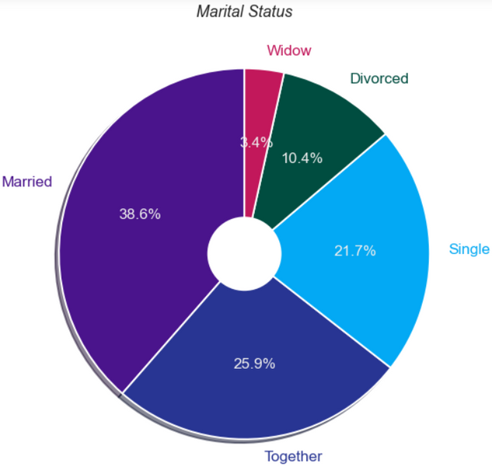
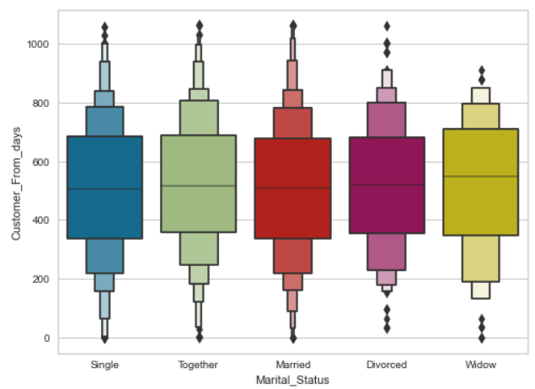
EDA
Q1:What is the relationship between the client’s joining date of the company and marital status?
The largest proportion of the company's customers are people who live with partners
There is no relationship between marital status and the date of joining the company
Samsung Innovation Campus
7

Slide 8

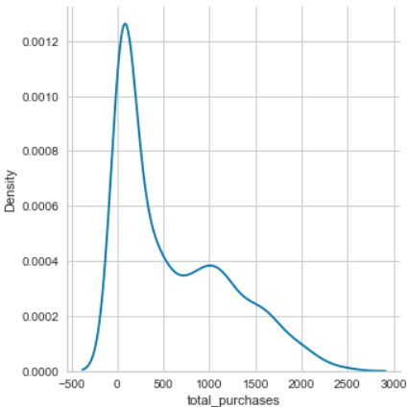
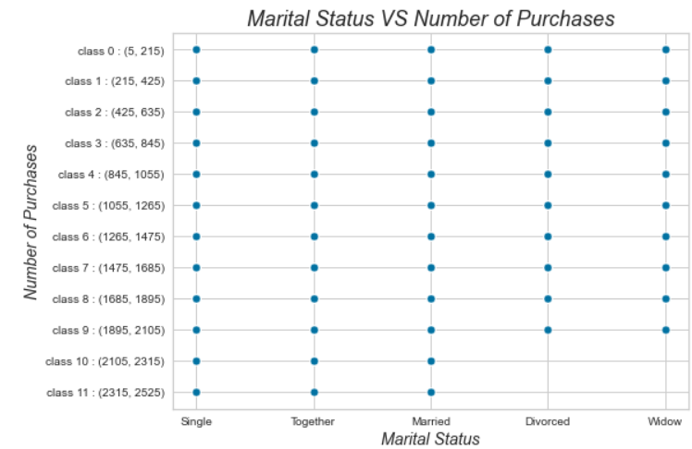
EDA
Q2: Does marital status affect the number of purchases?
Divorced and widowed clients are not included in the categories 10 and 11
Min:5 | Max: 2525
Samsung Innovation Campus
8

Slide 9
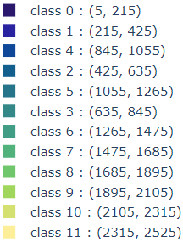
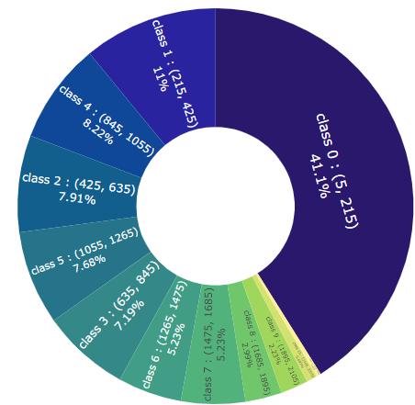
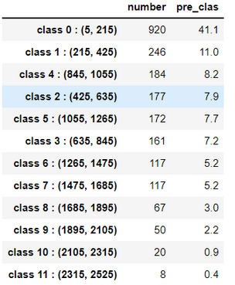

EDA
Q2: Does marital status affect the number of purchases?
That the largest percentage of the number of purchases made by customers and up to 41.1% was between 5 to 215 purchases.
Samsung Innovation Campus
9

Slide 10
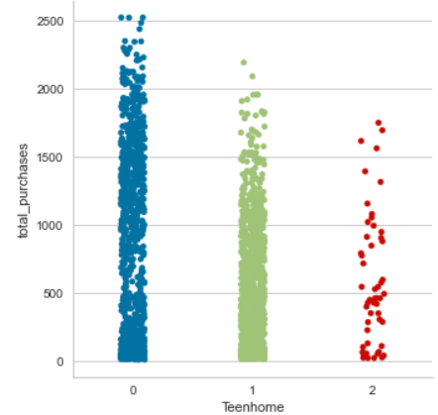
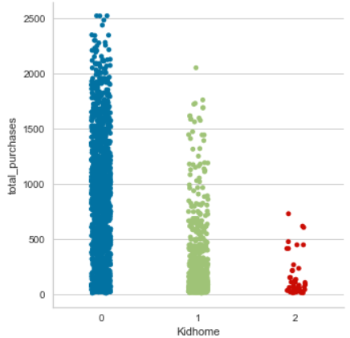

EDA
Q3: Is the size of the family and the number of children related to the number of purchases?
We see that customers with teenagers have more purchases than customers with children
Samsung Innovation Campus
10

Slide 11
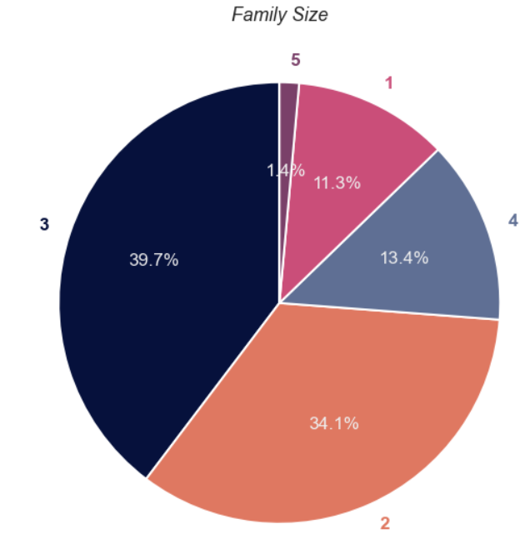
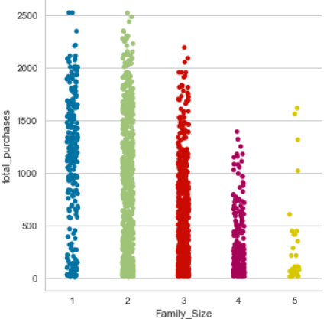
EDA
Q3: Is the size of the family and the number of children related to the number of purchases?
Most of the company's clients are families of two or 3
The figure shows that the higher the number of family members, the fewer purchases
Samsung Innovation Campus
11

Slide 12


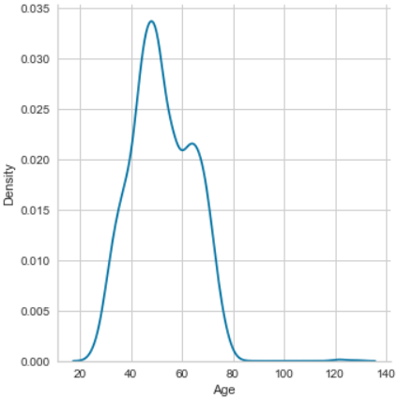
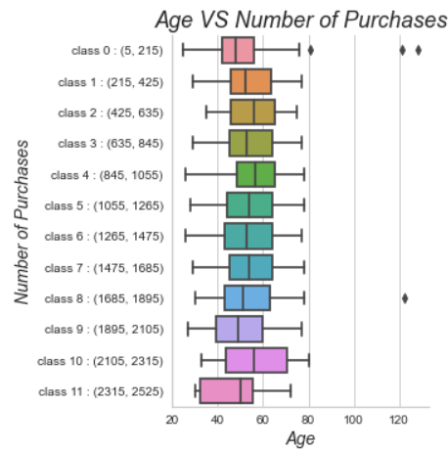
EDA
Q4: What does age have to do with the number of purchases?
Oldest customer: 128
Youngest customer: 25
There is no relationship between age and number of purchases
Samsung Innovation Campus
12

Slide 13
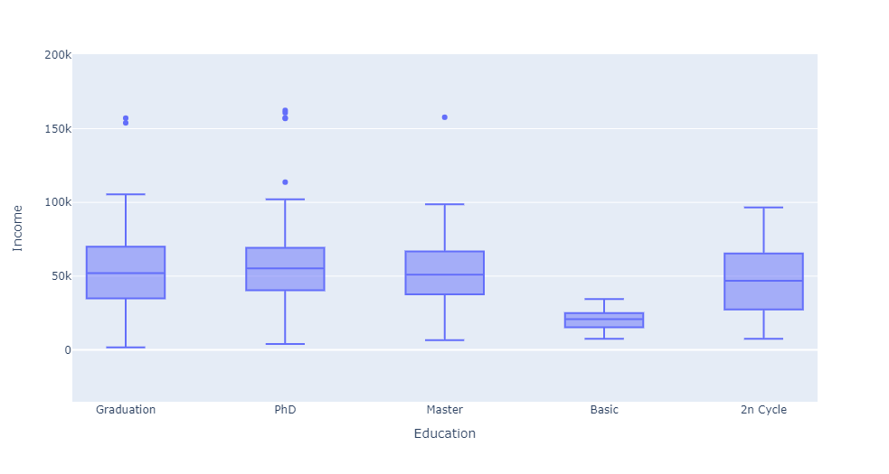

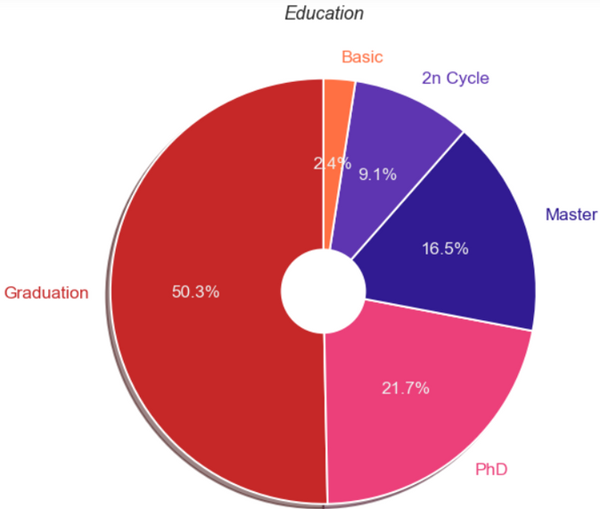
EDA
Q5: Do clients with better education get more income?
The percentage of clients with university degrees reaches 97.6%
The average income of all clients is very similar except for Basic
Samsung Innovation Campus
13

Slide 14
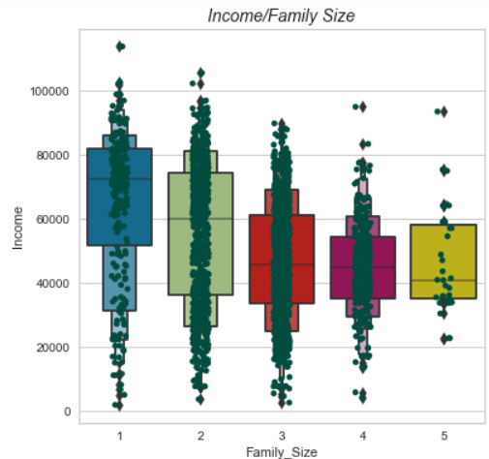
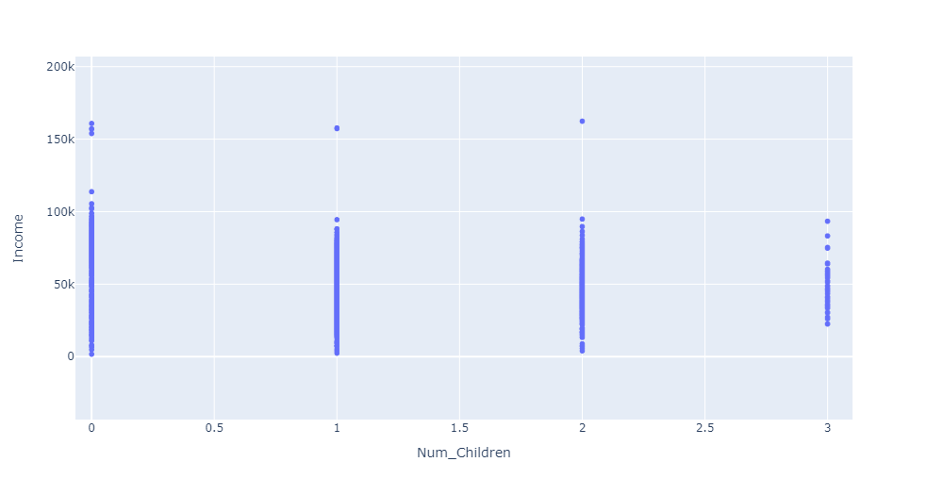
EDA
Q6: What is the relationship between income, family size and number of children?
All clients have approximately the same income, despite the difference in the number of children, except for those who have 3
The average income of clients is approximately the same, although the size of the family is not equal.
Samsung Innovation Campus
14

Slide 15
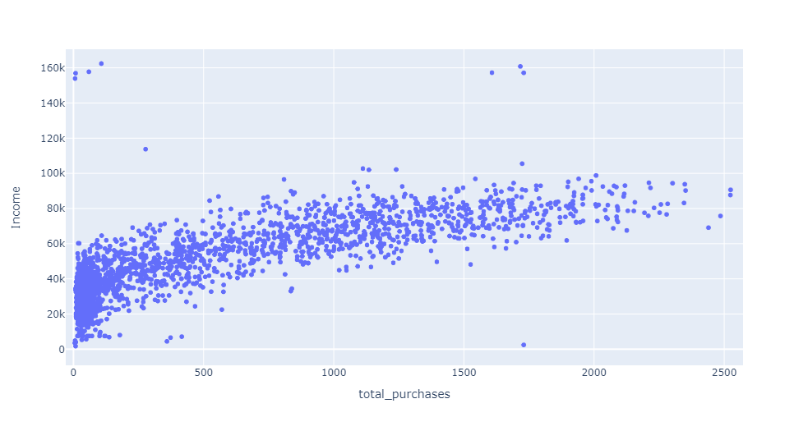
EDA
Q7: Do customers with more income make more purchases?
There is a near-linear relationship between income and the number of purchases
Samsung Innovation Campus
15

Slide 16

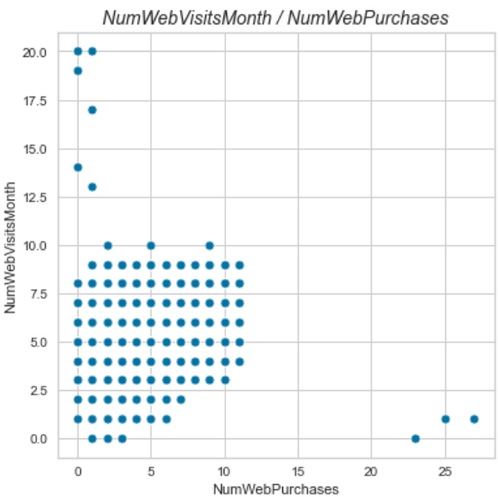
EDA
Q8:Do customers who visit the website make purchases through it or not?
In general, there is a linear relationship between the number of visits to the site and the number of purchases from it
Samsung Innovation Campus
16

Slide 17


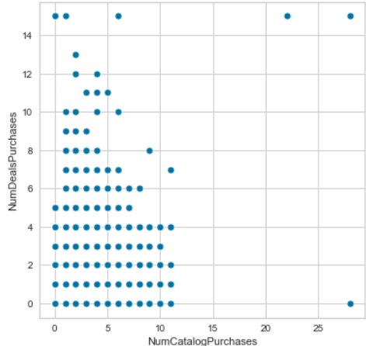
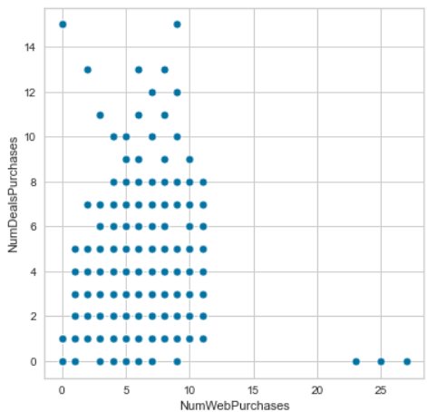
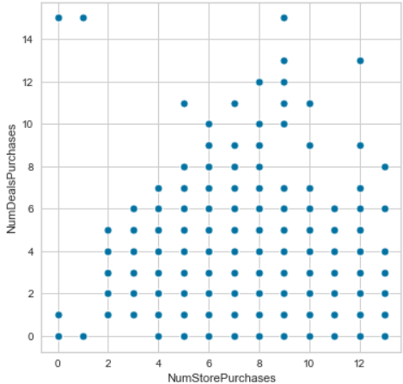
EDA
Q9:What is the most popular way for customers to buy at a discount?
We conclude that, in general, there is no relationship between the method of purchase (from the store, the website, the catalog) and the times of purchase at a discount
Samsung Innovation Campus
17

Slide 18


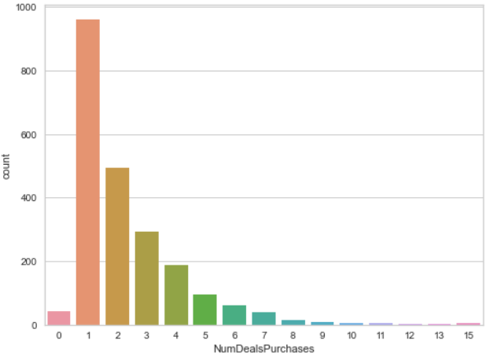

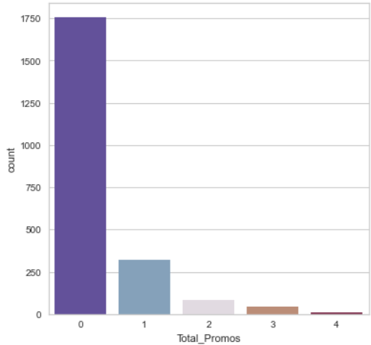
EDA
Q10:Are the promotions campaigns carried out by the company successful?
The number of customers who did not accept the offers is very large, up to 80%
Almost all customers have made a purchase at least once
Samsung Innovation Campus
18

Slide 19
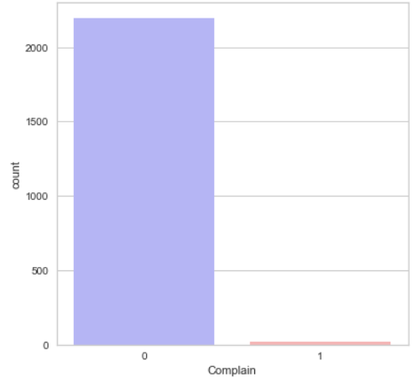
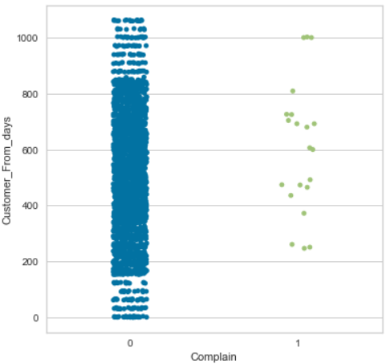
EDA
Q11:Are there complaints from customers, if yes, are they old or new customers?
Very few customers who complained
All customers who filed a complaint as if they were with the company more than 200 days ago
Samsung Innovation Campus
19

Slide 20

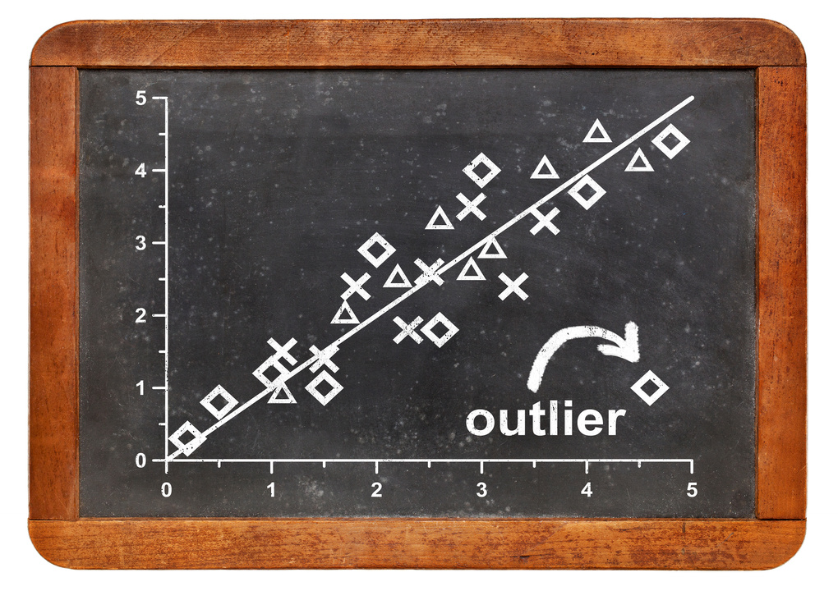
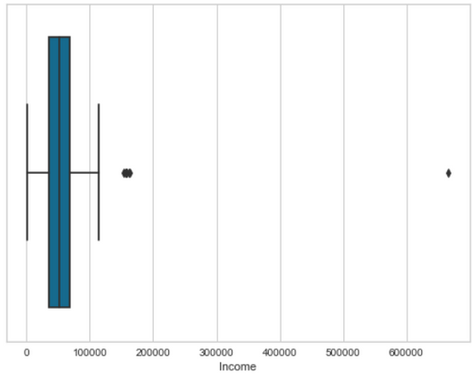
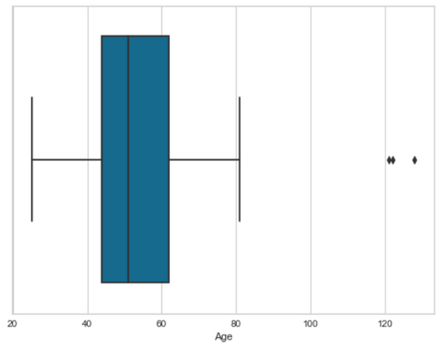
Data Preprocessing.
We dropped 13 features
1-ID 2-Year_Birth 3-Dt_Customer 4-AcceptedCmp3 5-AcceptedCmp4 6-AcceptedCmp5 7-AcceptedCmp1 8-AcceptedCmp2 9-Complain
10-Z_CostContact 11-Z_Revenue 12-Response 13-Living_With
Check if there are any outliers
We eliminated any income over 200,000 and any age over 100 years old
Samsung Innovation Campus
20

Slide 21

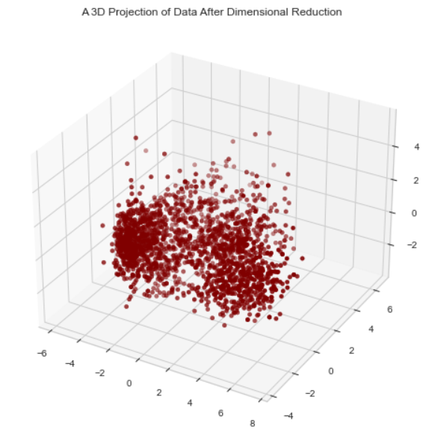
Data Preprocessing.
Label encoding the categorical features. Scaling the features using the standardscaler.
Using PCA to reduce the dimensions of the data.
Samsung Innovation Campus
21

Slide 22

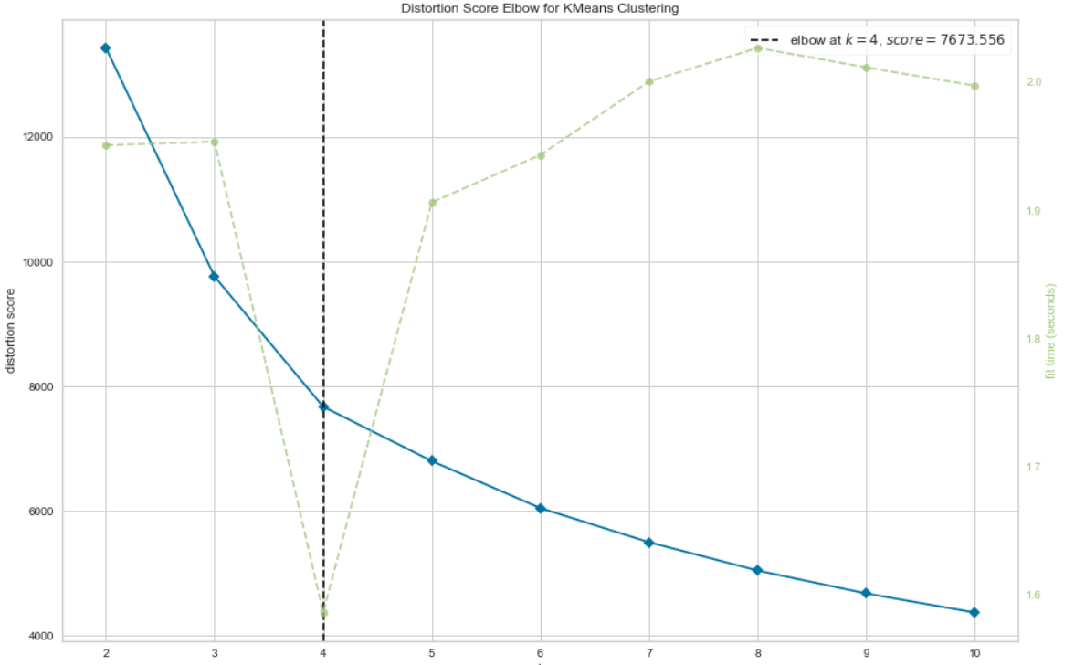

Clustering
Using the elbow method to find the optimal number of clusters
The optimal number of clusters is 4 .
Using Agglomerative Clustering and KMeans models
Samsung Innovation Campus
22

Slide 23

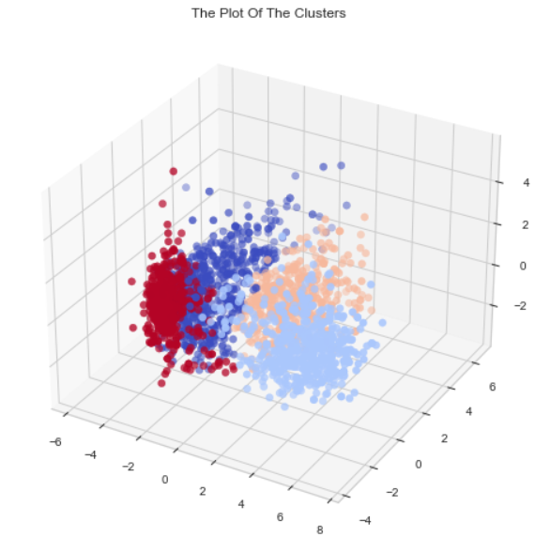
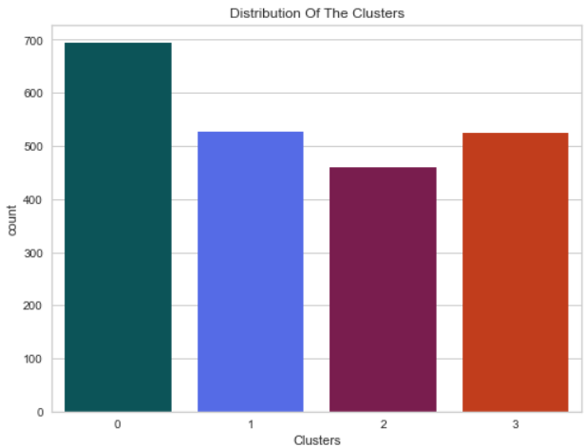
Evaluation Models.
A 3D Projection of Data After clustering using AgglomerativeClustering
Show numbers of clustering
Samsung Innovation Campus
23

Slide 24
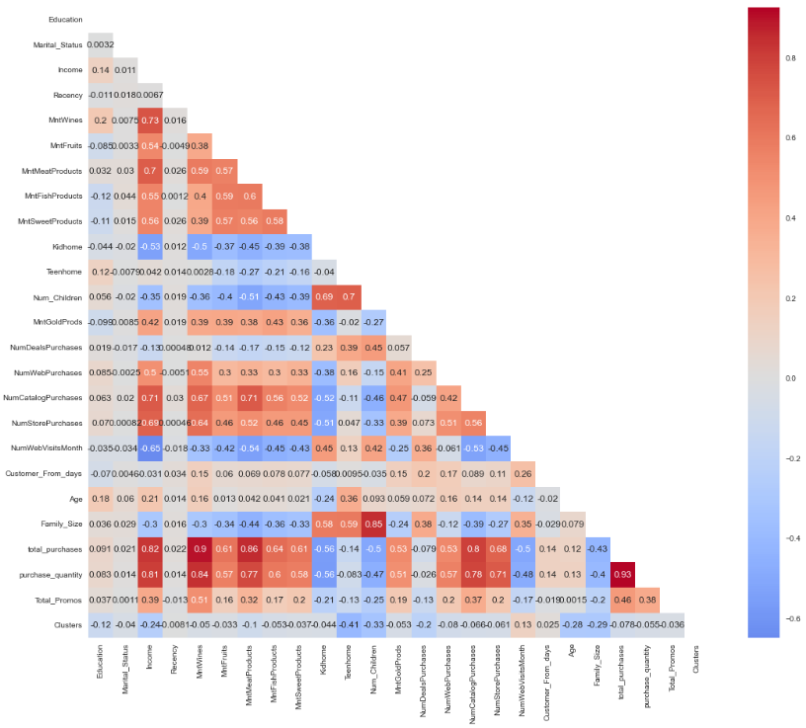
Evaluation Models.
The table shows how the features are related to each other.
Now we will see the relationship between some features and Clustering
Samsung Innovation Campus
24

Slide 25
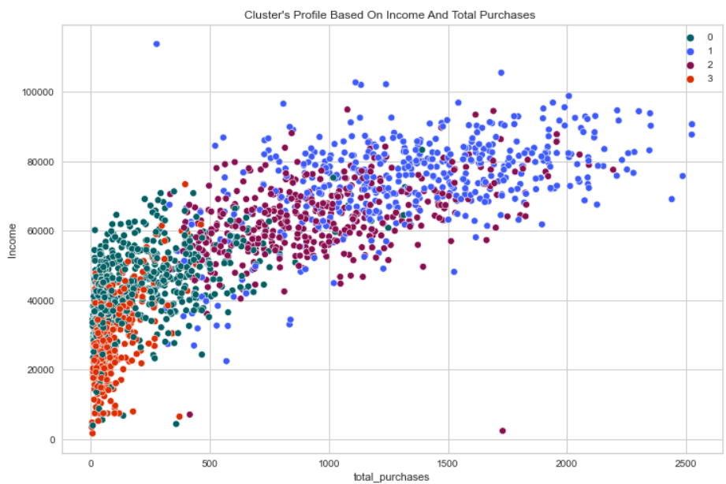
Evaluation Models.
AgglomerativeClustering
The figure shows that the classification process is based on the linear relationship between income and the number of purchases.
Samsung Innovation Campus
25

Slide 26

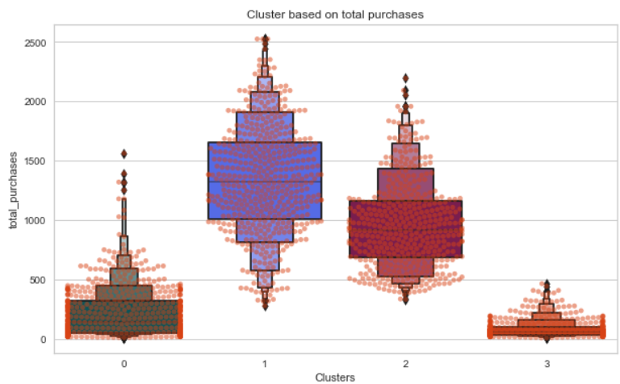
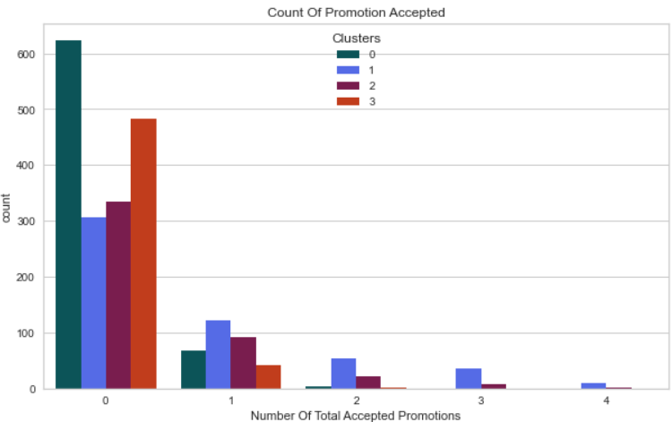
Evaluation Models.
AgglomerativeClustering
The numbers confirm that the customers were collected correctly.
Samsung Innovation Campus
26

Slide 27
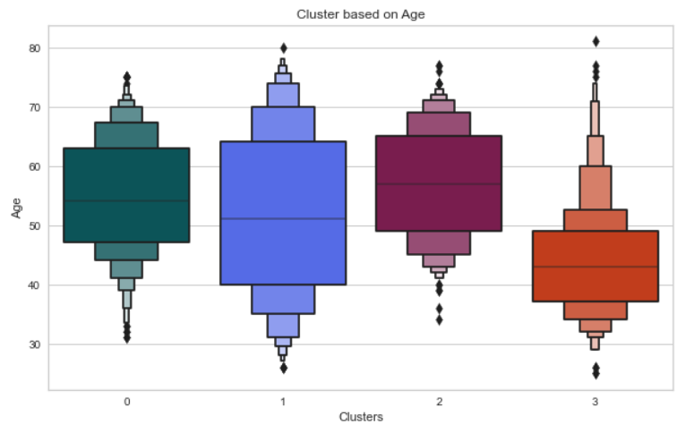
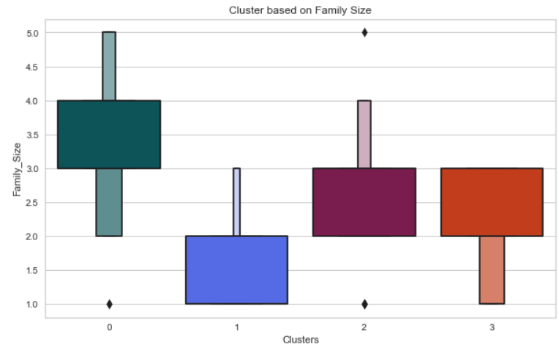
Evaluation Models.
AgglomerativeClustering
The numbers confirm that the customers were collected correctly.
Samsung Innovation Campus
27

Slide 28

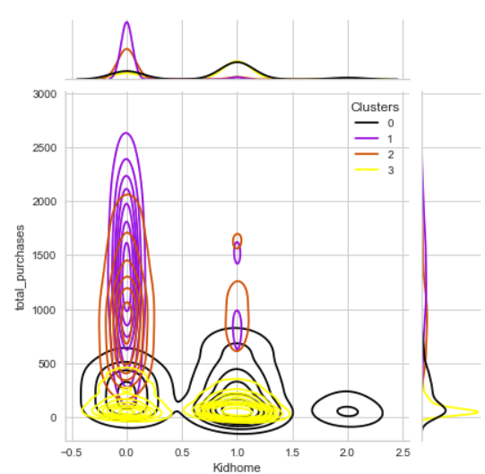
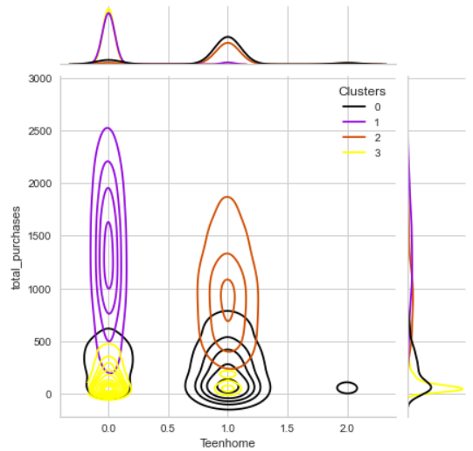
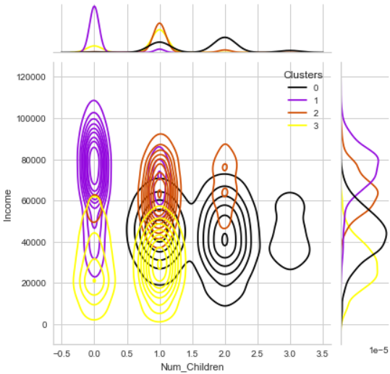
Evaluation Models.
Samsung Innovation Campus
28

Slide 29

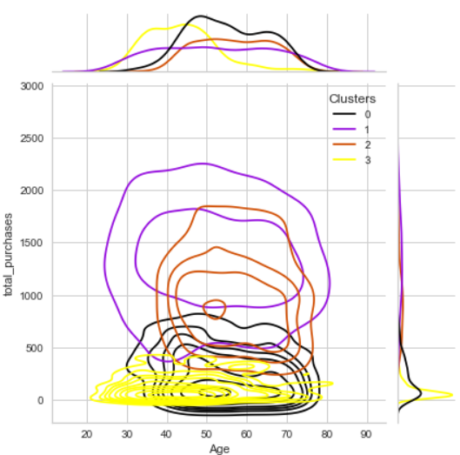
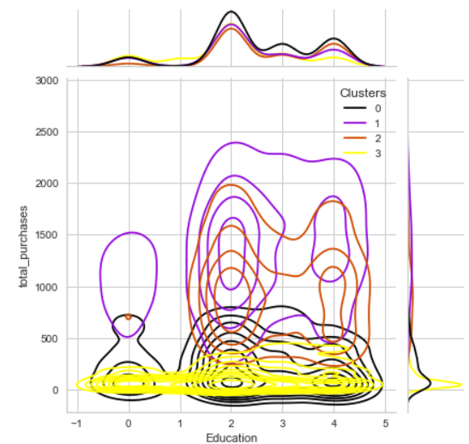
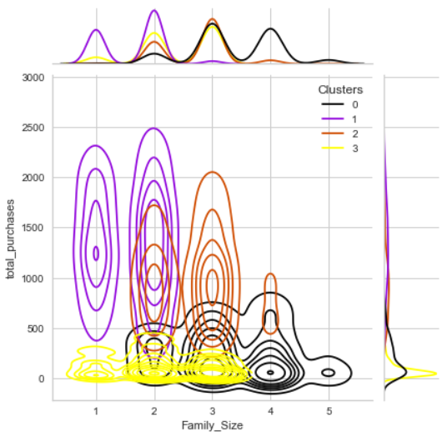
Evaluation Models.
Samsung Innovation Campus
29

Slide 30
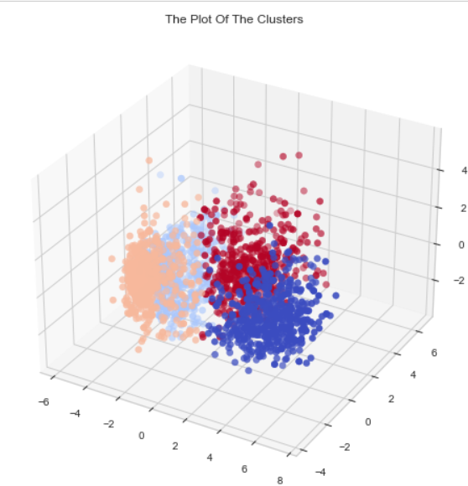
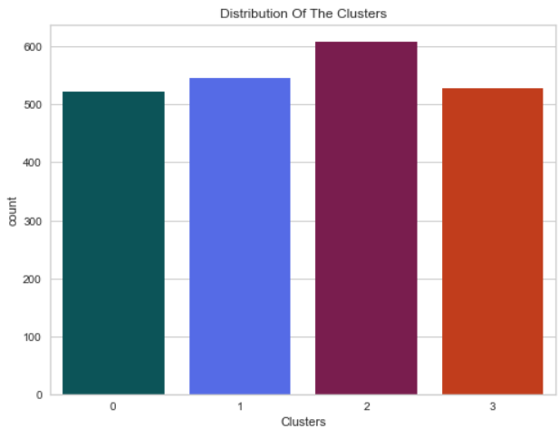
Evaluation Models.
A 3D Projection of Data After clustering using KMeans
Show numbers of clustering
Samsung Innovation Campus
30

Slide 31
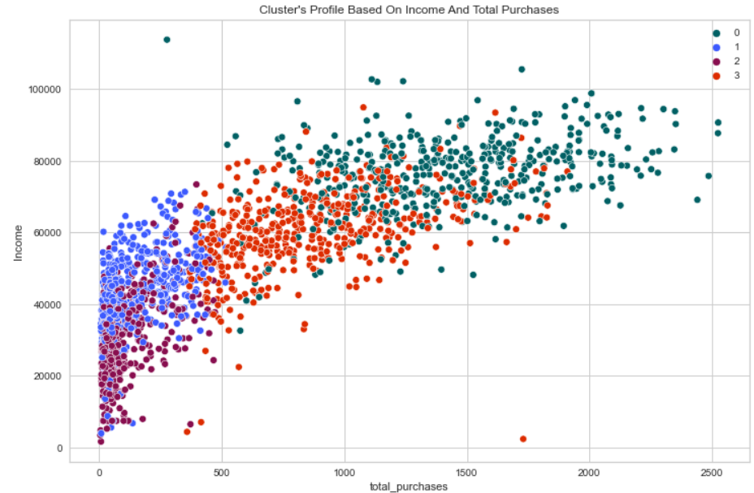
Evaluation Models.
KMeans
The figure shows that the classification process is based on the linear relationship between income and the number of purchases.
Samsung Innovation Campus
31

Slide 32
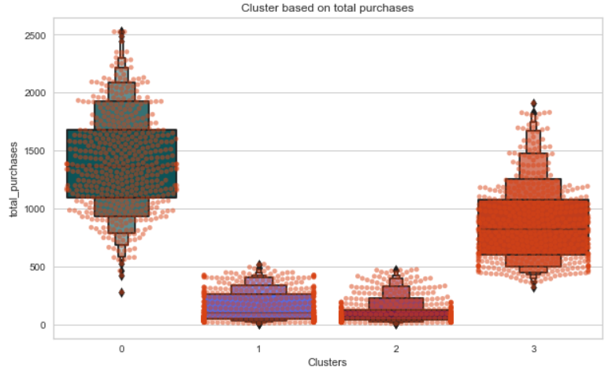
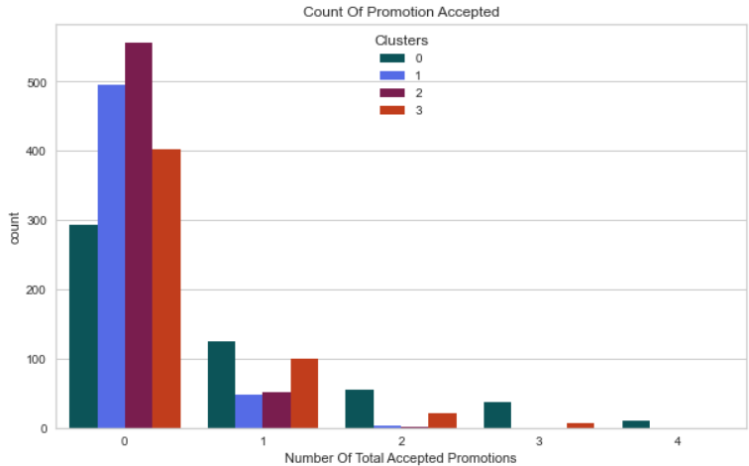
Evaluation Models.
KMeans
The numbers confirm that the customers were collected correctly.
Samsung Innovation Campus
32

Slide 33


Evaluation Models.
KMeans
The numbers confirm that the customers were collected correctly.
Samsung Innovation Campus
33

Slide 34



Evaluation Models.
Samsung Innovation Campus
34

Slide 35



Evaluation Models.
Samsung Innovation Campus
35

Slide 36



Clusters 0
Clusters 2
The min age of the customer is 35 and the max age is 77.
The min number of children is 1 and the max is 2.
The min number of kids is 0 and the max is 1.
The min number of teens is 0 and the max is 1.
The number of purchases s tarts from 500 to 2200.
Income between 40,000 to 90,000.
The min age of the customer is 30 and the max age is 75.
The min number of children is 0 and the max is 3.
The min number of kids is 0 and the max is 2.
The min number of teens is 0 and the max is 2.
The number of purchases reaches 600.
Income is between 20,000 and 70,000.
AgglomerativeClustering
Conclusion
Clusters 1
Clusters 3
The min age of the customer is 26 and the max age is 80.
The min number of children is 0 and the max is 1
The min number of kids is 0 and the max is 1.
The min number of teens is 0 and the max is 1.
The number of purchases starts from 500 to to 2525.
The income is between 50,000 and 110,000.
The min age of the customer is 25 and the max age is 82.
The min number of children is 0 and the max is 2.
The min number of kids is 0 and the max is 1.
The min number of teens is 0 and the max is 1.
The number of purchases is less than 500.
Income up to 60,000.

Slide 37
Clusters 1
Clusters 3
The min age of the customer is 31 and the max age is 77.
The min number of children is 0 and the max is 2.
The min number of kids is 0 and the max is 1.
The min number of teens is 0 and the max is 1.
The number of purchases starts from 350 to 1900.
Income between 35,000 to 90,000.
The min age of the customer is 40 and the max age is 75.
The min number of children is 1 and the max is 3.
The min number of kids is 0 and the max is 2.
The min number of teens is 0 and the max is 2.
The number of purchases reaches 500.
Income is between 15,000 and 70,000.
KMeans
Conclusion
Clusters 0
Clusters 2
The min age of the customer is 26 and the max age is 80.
The min number of children is 0 and the max is 1
The min number of kids is 0 and the max is 1.
The min number of teens is 0 and the max is 1.
The number of purchases starts from 500 to 2525.
The income is between 40,000 and 110,000.
The min age of the customer is 25 and the max age is 81.
The min number of children is 0 and the max is 2.
The min number of kids is 0 and the max is 2.
The min number of teens is 0 and the max is 1.
The number of purchases is less than 500.
Income up to 65,000.

Slide 38

31

Slide 39


ⓒ2021 SAMSUNG. All rights reserved.
Samsung Electronics Corporate Citizenship Office holds the copyright of book.
This book is a literary property protected by copyright law so reprint and reproduction without permission are prohibited.
To use this book other than the curriculum of Samsung innovation Campus or to use the entire or part of this book, you must receive written consent from copyright holder.

